Slide 1
Smart-traffic light aimed at reducing traffic congestion in the public environment
Creators : Zhaksylyk Nesibeli
Cappadokia, 2022

Slide 2
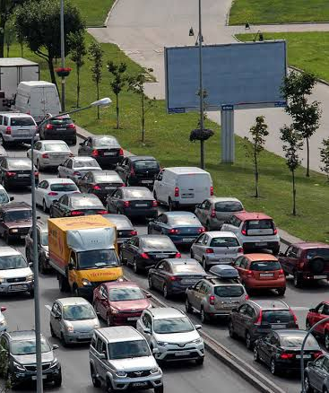
Because it is designed to regulate the flow of cars, and not create traffic jams.
The purpose of the project:
This project is called SMART TRAFFIC LIGHT Why SMART?

Slide 3
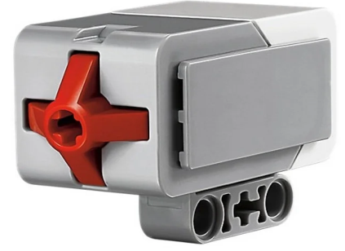
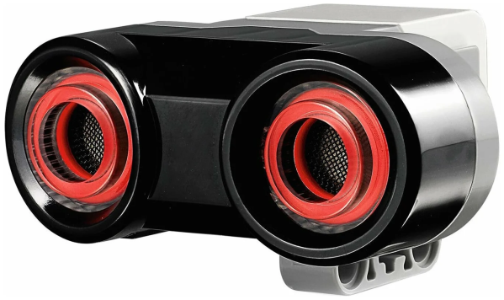
This project consists of : 4 medium motors 4 or 8 ultrasonic transducers 2 touch sensor 8 cables 2 wooden mini boxes 1 microcontroller
Necessary details for a smart traffic light:

Slide 4
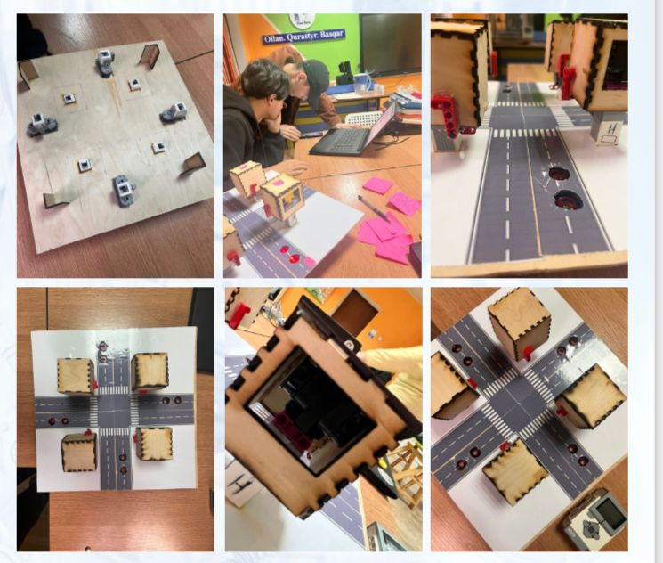
The result

